Slide 1
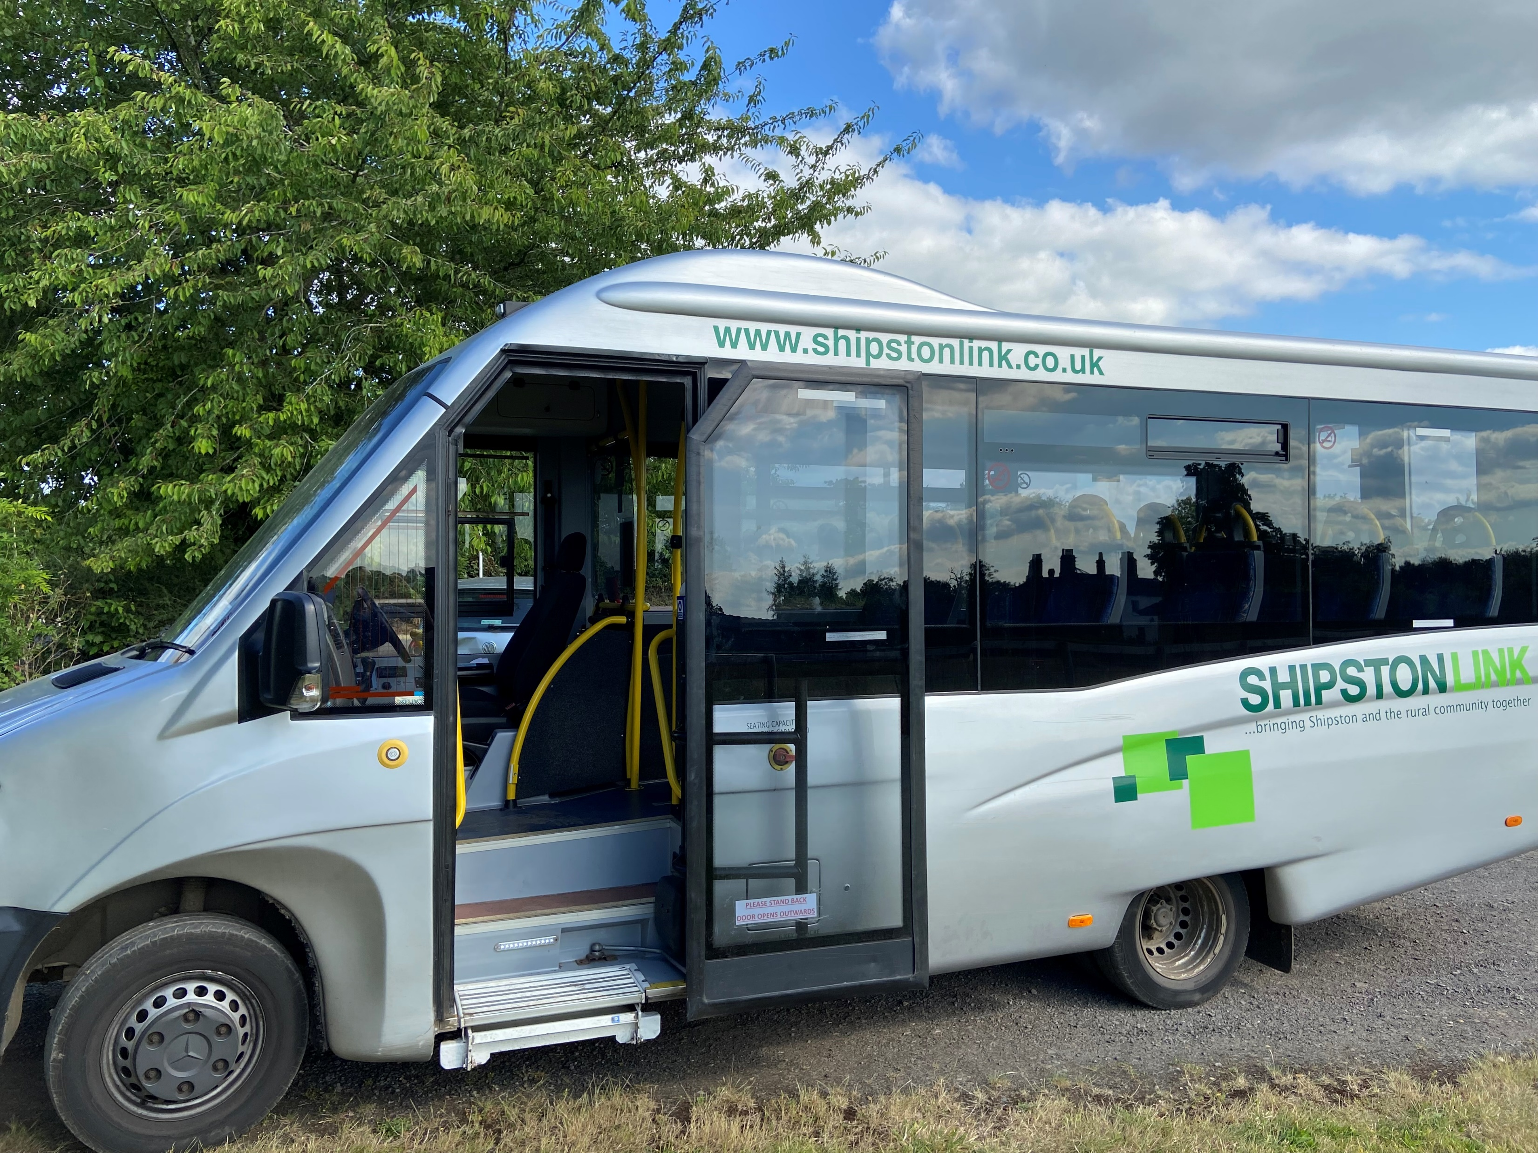
SHIPSTON LINK
Use it or lose it !

Slide 2
Shipston Link Ba ckground
Shipston Link is a community bus service which has been running for XX years
Shipston Link is a wholly voluntary organisation consisting of
Voluntary Management Team
Volunteer Drivers
Funded by Warwickshire County Council primarily and Oxfordshire District Council
Scheduled services run 5 days per week (Tuesday to Saturday)
Free travel for Older and Disabled Persons on all routes
Flat rate £2 adult fare for all routes except
to and from Banbury on a Thursday which is £3
Stratford to or from Whichford/Brailes on a Saturday which is £3
Private Hire vehicles available 7 days a week
17 seater Mercedes Sprinter
17 seater Ford Transit Mini-bus
Every hire requires a quote which will include the services of a qualified, fully insured volunteer driver

Slide 3
Shipston Link – Routes (part 1) (all timetables available on www.shipstonlink.co.uk)
Tuesday
Route 1 - Shipston, Tredington, Halford, Ettington, Halford, Tredington, Shipston Medical Centre, Shipston (and Return).
Route 4 - Shipston, Tredington, Armscote, Blackwell, Ilmington, Darlingscott, Shipston Medical Centre, Shipston (and Return)
Route 6 – Shipston, Stretton-on-Fosse, Todenham, Moreton-in-Marsh, Shipston (and Return)
Route 9 - (Shipston Town Run) Market Square, Campden Road, Furzehill Road, Callaways Road, Market Square, Medical Centre, Driftway, Berry Avenue, Sadlers Road, Market Square, Medical Centre (and Return)
Wednesday
Route 2 – Shipston, Upper Tysoe, Oxhill, Whatcote, Idlicote, Honington, Shipston Medical Centre, Shipston (and Return)
Route 3 – Shipston, Burmington, Wolford Fields, Cherington, Sutton-under-Brailes, Stourton, Cherington, Whichford, Long Compton, Chipping Norton (and Return)

Slide 4
Shipston Link – Routes (part 2) (all timetables available on www.shipstonlink.co.uk)
Thursday
Route 5 - Barton-on-the-heath, Little Compton, Long Compton, Whichford, Cherington, Stourton, Sutton-under-Brailes, Lower Brailes, Banbury High Street, Banbury Morrisons (and Return)
Friday
Route 7 – Shipston, Wolford Fields, Long Compton, Whichford, Cherington, Stourton, Sutton-under-Brailes, Lower Brailes, Upper Brailes, Shipston Medical Centre, Shipston (and Return)
Route 8 – Shipston, Burmington, Little Wolford, Great Wolford, Todenham, Stretton-on-Fosse, Shipston Medical Centre, Shipston (and Return)
Saturday
Route 10 – Whichford, Shipston, Illmington, Preston, Stratford (and Return)

Slide 5
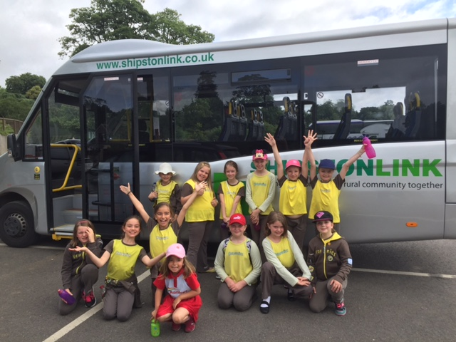
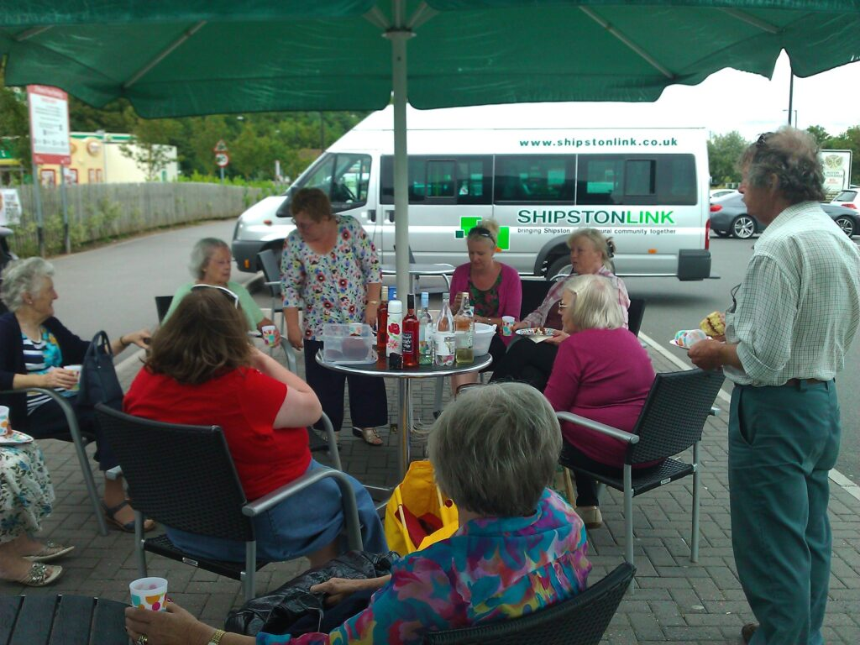
Shipston Link – Private Hire

Slide 6
Shipston Link – Conclusion
Additional volunteer drivers required due to impending retirements
D1 License required
1 day per month commitment only
Full driver training given
Suggestions for route changes that will increase usage very welcome
Please make use of this excellent service to ensure ongoing provision
Email : enquiries@shipstonlink.co.uk for general enquiries
Email : privatehire@shipstonlink.co.uk for private hire enquiries
Website : www.shipstonlink.co.uk

